Slide 1
Political Geography
"We live in a political world ..."
Bob Dylan
"In politics, stupidity is not a handicap."
Napoleon Bonaparte (attributed)

Slide 2
Definitions: "States" & "States"
"States"
States are political units that have:
Defined territories;
A permanent population;
Are fully independent and sovereign.
"States"
States are political units that are:
Part of a federal government;
Have limited independence (or sovereignty).
Sovereignty: control of internal affairs, without interference by other states.
"Country" is roughly equivalent to "state."

Slide 3
Definitions: "Nations" & "Nation-States"
"Nations"
Nations are communities or groups of people:
Common culture;
Sense of unity, shared beliefs, language, and customs;
Usually have a strong attachment to a place.
"Nation-States"
A State occupied by a single nation:
Considered ideal;
No perfect examples, but some (e.g. Japan, Norway, Lesotho) come fairly close.
Can nation-states be created? Maybe!

Slide 4
Variations on "Nation" & "State"
"Multinational State"
A state whose population is made up of two or more nations.
Examples: Cyprus, Russia, Canada
"Part-Nation State"
A state whose population is only a portion of a nation.
Examples: Egypt, Syria, Libya, Jordan
"Stateless Nation"
A nation which has no state (or sovereignty), or is divided among several states.
Examples: Basques, Kurds, Gypsies

Slide 5
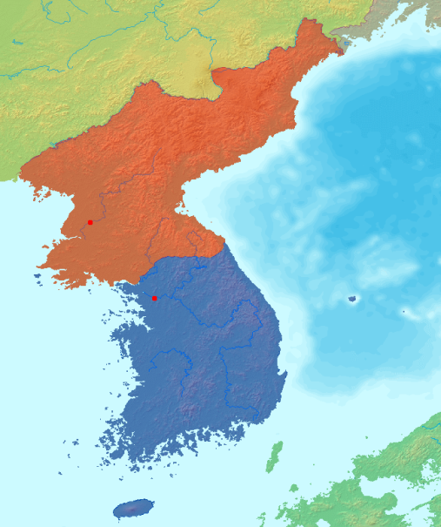
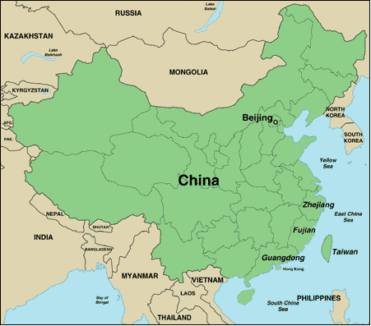
Defining States: Problems
Korea
Since 1945 the Korean Peninsula has been divided; since 1953 a four kilometer demilitarized zone has divided North and South Korea.
Since the 1990s there have been a number of small attempts to reconcile. In 2000 the Presidents of North and South Korea met for the first time.
China & Taiwan
In 1949, during the Chinese Civil War, the government of China retreated to the island of Taiwan. When they lost, and the People’s Republic of China was created, Taiwan remained as holdout.
Taiwan was a one-party state under martial law until 1987. Today there is a Taiwanese independence movement – which is strongly resisted both by the People’s Republic and by some Taiwanese.
Western Sahara
The former Spanish Sahara.
Claimed by more than one nation.
Sources: http://commons.wikimedia.org/wiki/Image:Map_korea_without_labels.png;
http://usinfo.state.gov/eap/east_asia_pacific/chinese_human_smuggling/smuggling_maps/china_map.html

Slide 6
Western Sahara’s Wall
Sources: http://en.wikipedia.org/wiki/Image:Westernsaharamap.png; http://maps.google.com/?t=h&ie=UTF8&om=1&ll=21.348823,-16.203488&spn=0.003727,0.005246; http://news.bbc.co.uk/2/hi/in_pictures/4588982.stm

Slide 7
The World is Almost All States
Note overlapping claims
There is only one large piece of land anywhere on earth that is not controlled by a state – Antarctica.
At least until 2041, all territorial claims here have been suspended – but they have not been abandoned.

Slide 8
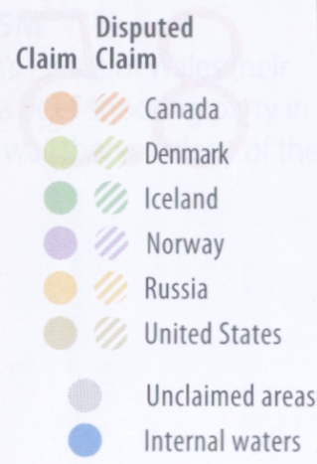
Claims to the Arctic
Oil and natural gas, as well as coal, copper, gold, iron, nickel, tungsten, uranium are all found in the Arctic.
As technology and climate change make this area more accessible, more nations are trying to assert their claims to the region (including offshore regions).

Slide 9
The Rise of States
Nations have existed from time immemorial.
States, in some sense at least, have existed for thousands of years.
"City-States" in Mesopotamia and Greece.
Early political empires (Agade, Egypt, Zhou, Rome, etc.)
The modern concept of the nation-state only dates back to Europe in the 17th-19th centuries.
As recently as 1950 there were only about 50 internationally recognized independent countries; now there are nearly 200 (and more may be coming!)

Slide 10
Colonies
Why did Europe establish colonies?
GOD! (cultural imperialism)
GOLD! (profit, resources)
GLORY! (status)
The largest colonial powers were England, France and Spain.
Colonial policies varied from integration to pure exploitation.
Decolonization – sometimes a violent process – ended the colonial era in the 20th century. There are only a few colonies today – mostly islands.
A colony is a territory that is legally joined to a sovereign state, and is not completely self-governing.
The sovereign state may control the colony completely, or may just control some aspects (defense, foreign affairs).
During the last 500 years, colonies were planted by European countries over much of the world.

Slide 11
The Colonial World, 1914

Slide 12
Africa: 1939 vs. 2010

Slide 13
Colonies & Possessions Today

Slide 14
Physical Characteristics of States
Size
States vary greatly in size, from enormous to microstates:
The Russian Federation – 6,592,850 mi² (17,075,400 km²).
Vatican City 109 acres (44 hectares, or about .17 mi²).
Shape
States have five basic shapes:
ELONGATED (long, narrow shape – may cause a portion of a country to be isolated or vulnerable).
FRAGMENTED (discontinuous territory – mostly island nations today).
PERFORATED (one state completely surrounds another – an "enclave").
PRORUPT ["Panhandle"] (projecting extension – usually created either to prevent other states from contact, or to access resources).
COMPACT (considered ideal – theoretically very efficient).
#TERRITORIALMORPHOLOGY

Slide 15
Shapes of States
Compact
Prorupt
Elongated
Fragmented
Perforated

Slide 16
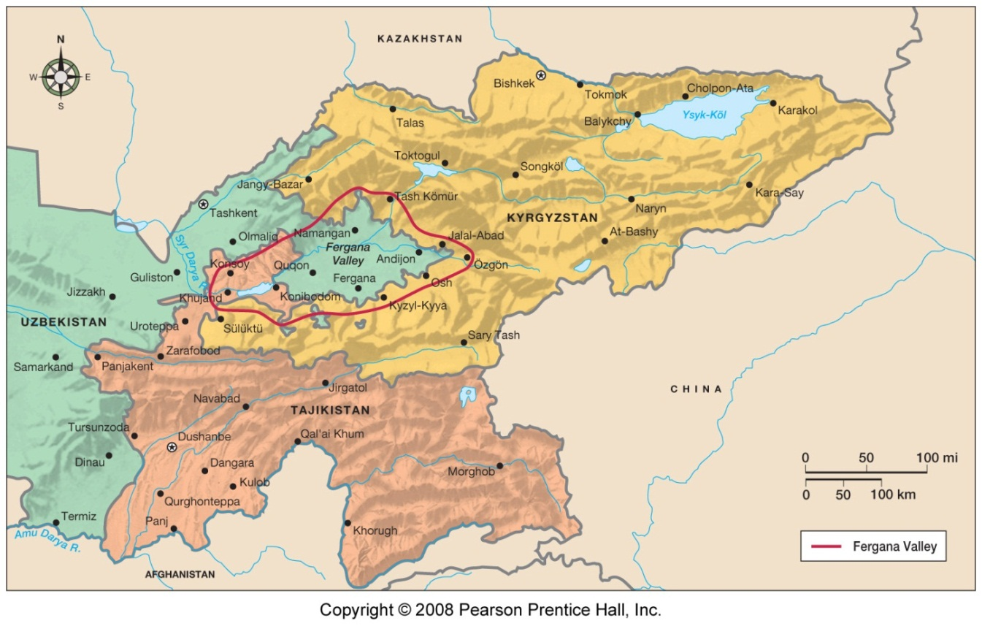
Enclaves & Perforations: The Fergana Valley
Decent farmland is limited in this region, and under the Soviets control of the Fergana Valley was divided among Kyrgyzstan, Tajikistan & Uzbekistan – which were all part of the USSR.
Today all three are independent countries, and have to deal with hideously complex borders.

Slide 17
Fergana Valley: Perforations & Enclaves
Source http://www.cominganarchy.com/wordpress/wp-content/old_uploads/ferganaenclaves.jpg

Slide 18
Landlocked States
Landlocked states have no direct access to the sea – so their access to international trade is severely limited.
Landlocked states have to depend on the cooperation of their neighbors.

Slide 19
Boundaries
Until modern times, most countries were separated by frontiers – zones where no state has political control.
Boundaries may be either physical or cultural.
PHYSICAL BOUNDARIES
Physical boundaries should be easily distinguished, permanent, and (ideally) hard to cross.
Examples: Mountains, deserts, bodies of water.
CULTURAL BOUNDARIES
Cultural boundaries also ought to be easily distinguished, and permanent – but that is not always possible.
Examples: Ethnic (language, religion), geometric
The best boundaries are those everyone accepts – regardless of how they are drawn!

Slide 20
Frontiers

Slide 21
Physical Boundaries
Water
Desert
Mountains

Slide 22
Problems With Physical Boundaries
Unless they are truly impassable – and with modern technology, nothing is – physical boundaries only work well if everyone agrees on them.
Defining boundaries is often contentious.
Water boundaries have special problems:
Rivers shift courses.
Oceans don’t have obvious boundaries – and nations can claim large areas for security or economic reasons.
"In the exclusive economic zone, the coastal State has sovereign rights for the purpose of exploring and exploiting, conserving and managing the natural resources, whether living or non-living ... The exclusive economic zone shall not extend beyond 200 nautical miles …" Convention on the Law of the Sea, Part V
Sources: http://www.hri.org/docs/LOS/part5-1.html; http://earthguide.ucsd.edu/fishes/kinds/images/eez_us.jpg

Slide 23
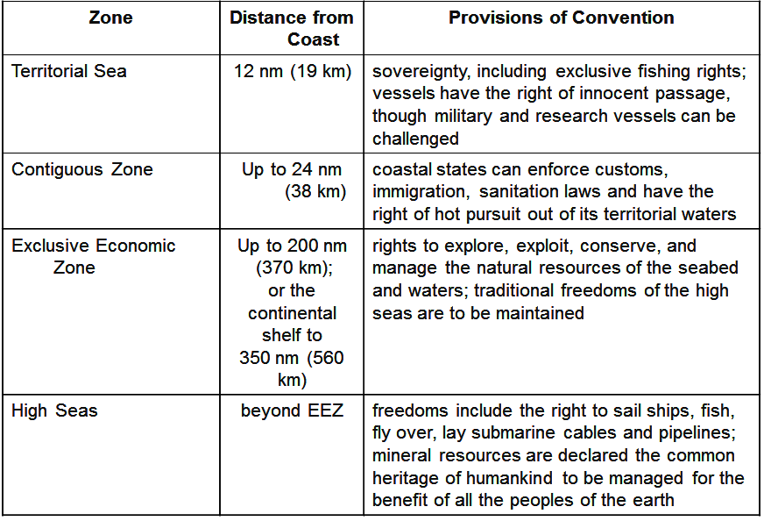
UN Convention on the Law of the Sea
Keep in mind – the US has not signed the Convention (though it helped negotiate it).

Slide 24
Cultural Boundaries
ETHNIC (religious & linguistic)
Boundaries drawn on the basis of cultural characteristics.
No country on earth has perfect cultural boundaries – because no country is a perfect nation-state.
GEOMETRIC ("mathematical")
Arbitrary lines drawn on the map, without regard to physical or other cultural factors.
Usually drawn before an area has a significant population.

Slide 25
An Ethnic Boundary: Cyprus

Slide 26
Irredentism
Irredenta are regions that are culturally or historically related to one country, but ruled by another country.
Ethnic enclaves can cause friction both within countries and between countries.
In most of the world national boundaries do not correspond to ethnic boundaries.

Slide 27
Other Kinds of Boundaries?
RELICT BOUNDARIES
Former boundaries, which may no longer have much (or any) legal standing, but are still visible in the landscape.
Examples: Wales-England; Spain-Britain (the 42º N North American boundary – now the California-Oregon boundary).
BUFFER STATES & SATELLITE STATES
Independent states used by major powers to reduce mutual conflict ("satellite" states are dominated by a major power – but are technically independent).
Examples: Eastern Europe during the Cold War; Mongolia; Nepal.

Slide 28
A Relict Boundary: Hadrian’s Wall
In the year 122 the Roman Empire built a fortification across the north of England, dividing the Empire’s territory from that of the "barbarian" Scots to the north.
The Emperor Hadrian’s Wall was the most heavily fortified border in the Empire, and helped establish the boundaries of England and Scotland – but it’s not the border today.
Today what’s left of the Wall is entirely within England.

Slide 29
Buffers
All of the highlighted countries have been considered "buffer states":
Eastern Europe (between the USSR and US allies in Western Europe).
Mongolia (between China and Russia)
Nepal and Bhutan (between India and China)
Jordan (between Saudi Arabia and Israel)

Slide 30
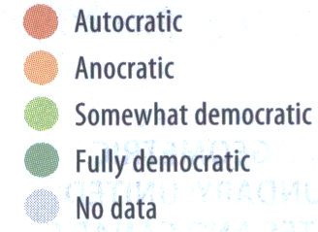
Democratic, Autocratic and “Anocratic” States
Democracy: Government by the people.
Autocracy: Government by the ruler(s).
Anocracy: Neither fully democratic nor autocratic.

Slide 31
Internal Organization of States
Unitary States:
Strong central government – country as a single "unit";
Local governments have little or no power or responsibilities (except to implement central government policies);
Can be democratic, but often totalitarian, one-party;
Theoretically ideal for small, homogenous states, but many large states have been unitary.
Federal States:
Contractual arrangement divides power between central and local governments — "allocation of residual powers";
May be "weak" or "strong";
Theoretically large, multinational states, but an increasing number of states today are federal.
It can be hard to tell the difference between a strong federal state and weak unitary state!

Slide 32
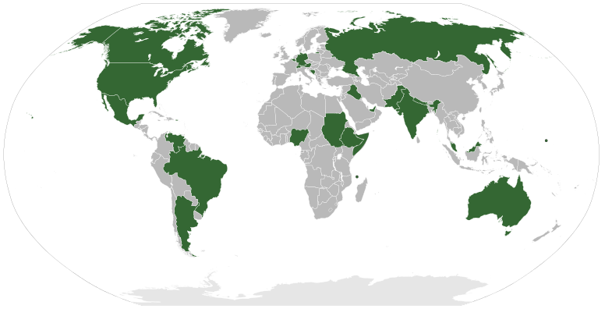
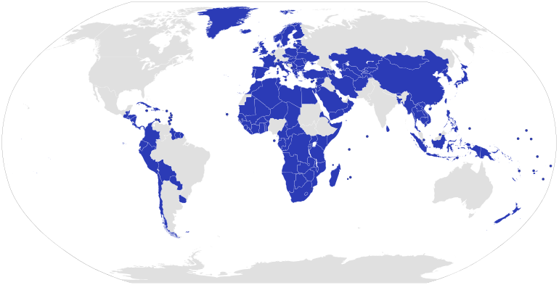
Federal & Unitary States
Federal States
Unitary States

Slide 33
US Constitutional Limits on Federal Power
"The powers not delegated to the United States by the Constitution, nor prohibited by it to the States, are reserved to the States respectively, or to the people."
Tenth Amendment to the U.S. Constitution

Slide 34
US Constitutional Limits on State Power
"No State shall enter into any Treaty, Alliance, or Confederation … coin Money … pass any … ex post facto Law … or grant any Title of Nobility.
"No State shall, without the Consent of the Congress, lay any … Duties on Imports …
"No State shall, without the Consent of the Congress … keep Troops, or Ships of War in time of Peace, enter into any Agreement or Compact with another State, or with a foreign Power, or engage in War, unless actually invaded, or in such imminent Danger as will not admit of delay."
Excerpts from Article 1, Section 10, U.S. Constitution

Slide 35
Electoral Geography
In democracies (unitary or federal), there are many steps and many questions that have to be answered in determining how a state will be run:
Who votes? (Historical expansion of suffrage)
Who can be elected? (Eligibility – citizenship, party membership, poll tax, etc.)
Who wins?
Majority (or plurality) vs. run-off.
Proportional vs. winner-take-all.
How are electoral district boundaries drawn?

Slide 36
Being "Fair"

Slide 37
The Gerrymander
"...the deliberate manipulation of political district boundaries to achieve a particular electoral outcome."
This originally appeared in 1812 in The Boston Messenger, and is supposed to have been drawn by the painter Gilbert Stuart. See http://historytogo.utah.gov/hmgerry.html

Slide 38
Racial Gerrymandering

Slide 39
2010 North Carolina Congressional Districts
District 12
Source: http://nationalatlas.gov/printable/congress.html

Slide 40
Gerrymander Species
By law, Congressional district boundaries must be "contiguous and compact," have roughly equal populations, and can’t be drawn solely to benefit one political party. They can be drawn on the basis of "shared interests."
There are three types of gerrymander:
Wasted vote: Dilute opposition so that it can’t win ("cracking").
Excess vote: Concentrate opposition so that it can only win a few districts ("packing").
Stacked vote: Connecting and concentrating groups.

Slide 41
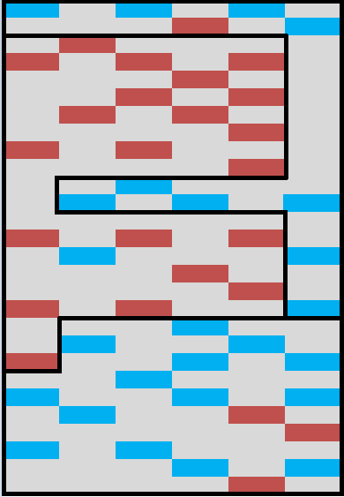
Cracking, Packing and Stacking
Blue is gerrymandering.
District 1 is stacked (and packed). (blue communities that are widely separated are connected).
District 2 is packed (red communities are concentrated in one district).
District 3 is cracked (red communities are "diluted" in a sea of blue communities).
The result? Blue should always win two districts, red one.
1
2
3

Slide 42
But Are All Funny-Looking Districts Gerrymanders?
"[U]nconstitutional discrimination occurs only when the electoral system is arranged in a manner that will consistently degrade a voter's or a group of voters' influence on the political process as a whole...[S]uch a finding of unconstitutionality must be supported by evidence of continued frustration of the will of a majority of voters of a fair chance to influence the political process." (U.S. Supreme Court, Davis v. Bandemer 1986)
Gerrymanders are illegal – but just because an electoral district is weird looking – even if it gives one group or political party an advantage – it isn’t necessarily illegal.

Slide 43
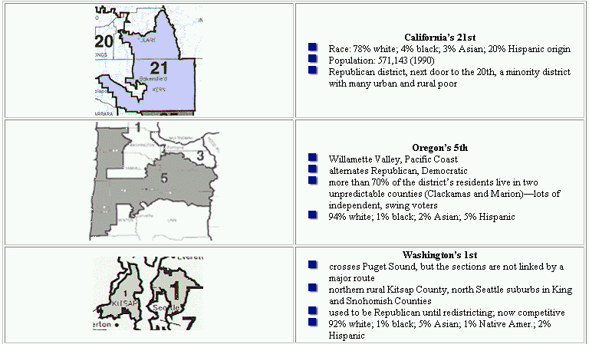
Not Gerrymanders
Source (10-24-01): http://www.fairvote.org/redistricting/irregularWest.htm

Slide 44
Not Gerrymanders?!?
Source (10-24-01): http://www.fairvote.org/redistricting/irregularTX.htm

Slide 45
California’s Congressional Districts
Districts in California in 2010 were determined by the Citizens Redistricting Commission.
California has 53 Representatives.
Source: http://www.joincalifornia.com/page/8;
See also http://wedrawthelines.ca.gov/maps-final-draft-congressional-districts.html

Slide 46
San Diego’s Congressional Districts
Adapted from: http://swdb.berkeley.edu/gis/gis2011/;
see also http://wedrawthelines.ca.gov/downloads/meeting_handouts_072011/viz_20110728_q2_cd_finaldraft_kmz.kmz

Slide 47
Texas’s Reapportionment: 2001 vs. 2003
2001
2003
In 2004 the Supreme Court (in Vieth v. Jubelirer); 2006 Supreme Court decision in League of United Latin American Citizens v. Perry determined that states may redistrict whenever they like. All but one of these districts was found acceptable – not gerrymanders.
Source: http://www.lib.utexas.edu/maps/texas.html

Slide 48
Focus on Texas’ 25th District
Source: http://filipspagnoli.wordpress.com/2011/05/10/human-rights-maps-134-gerrymandering/

Slide 49
The 2012 Presidential Election: by State & by County
Source: http://www-personal.umich.edu/~mejn/election/2012/

Slide 50
The 2012 Presidential Election: State Population Cartogram
Source: http://www-personal.umich.edu/~mejn/election/2012/

Slide 51
The 2012 Presidential Election: Electoral College Cartogram
Source: http://www.facebook.com/NoTeaParty/

Slide 52
How the 2012 Press Saw the Electoral College

Slide 53
The 2012 Presidential Election: The "Purple County" Analysis
Blue=70% Democrat
Red=70% Republican
Source: http://www-personal.umich.edu/~mejn/election/2012/

Slide 54
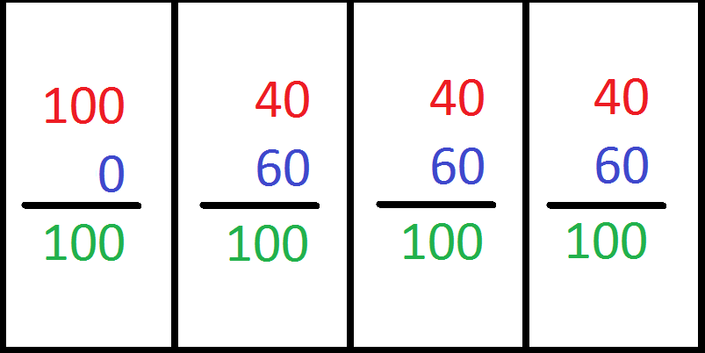
"Fairness" & the Electoral College
Contrary to popular belief, we do not elect a President every four years.
Instead, each state selects electors – California has 55, each state has at least 3 – and they vote for President.
Most states follow a "winner-take-all" system. Two, Maine and Nebraska, apportion their electors by district.
The Electoral College system has produced some odd results – 15 Presidents have been elected without winning the popular vote.

Slide 55
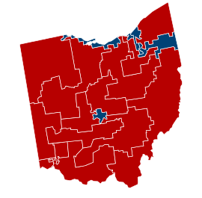
"Fairness" & Congressional Representation: Ohio 2012
Ohio has 16 Congressional districts.
Of those, 12 are now held by Republicans, 4 by Democrats.
But the overall vote ratio of Democrats to Republicans is 47/53 – and based on that ratio you’d expect at least 7 Democrats.
Is this evidence of gerrymandering?
Maybe! Maybe not!
Source: http://www.politico.com/2012-election/results/house/ohio/; http://ballotpedia.org/wiki/index.php/Marcia_L._Fudge;
http://ballotpedia.org/wiki/index.php/John_A._Boehner

Slide 56
“How a Bill Becomes a Law”
http://www.youtube.com/watch?v=Otbml6WIQPo

Slide 57
International Cooperation
States frequently find it both possible and profitable to cooperate.
There are two basic scales of interstate cooperation:
Regional
Global
There are three basic kinds of interstate cooperation:
Political (or cultural)
Military
Economic
Please note: political, military and economic associations are not new – for example, the Delian League (478 BCE), the Hanseatic League (13th Century), the Rome-Berlin Axis (1936).

Slide 58
Regional Alliances: Examples
Military
NATO and the Warsaw Pact in Europe after World War II.
The Allies and the Central Powers in Europe during World War I.
Political
Sometimes based on propinquity (e.g. the Organization of American States, the Organization of African Unity), or shared historical
Sometimes based on ethnicity or cultural connections (e.g. the British Commonwealth of Nations, the Arab League).
Economic
The European Common Market (which became the European Union), the North American Free Trade Association (NAFTA).
Can evolve into a political or military alliance.

Slide 59
The European Union & The Eurozone: Monetary Alliance within an Alliance
The European Union in 2012
The Eurozone in 2012

Slide 60
Global Alliances
Until modern times the idea of global alliances was ridiculous. However, by the 18th century, interstate wars became global – the Seven Years War (1756-1763) between Britain and France was fought on every continent except Antarctica, and European countries were in an almost constant state of conflict on a global scale because of colonialism.
After the disaster of the First World War (1914-1918), the League of Nations was formed in 1920 to try and prevent conflicts from becoming wars. At its height, the League had 63 member nations (but never included the United States).
After the Second World War (1939-1945) the League of Nations was replaced with the United Nations, which today has 193 member states.

Slide 61
The UN Today
There are 193 member states today (the newest: South Sudan)
The only widely-recognized "states" that are not members of the United Nations today are Taiwan and Vatican City.

Slide 62
The UN Charter
WE THE PEOPLES OF THE UNITED NATIONS DETERMINED
to save succeeding generations from the scourge of war, which twice in our lifetime has brought untold sorrow to mankind, and to reaffirm faith in fundamental human rights, in the dignity and worth of the human person, in the equal rights of men and women and of nations large and small, and to establish conditions under which justice and respect for the obligations arising from treaties and other sources of international law can be maintained, and to promote social progress and better standards of life in larger freedom,
AND FOR THESE ENDS
to practice tolerance and live together in peace with one another as good neighbors, and to unite our strength to maintain international peace and security, and to ensure by the acceptance of principles and the institution of methods, that armed force shall not be used, save in the common interest, and to employ international machinery for the promotion of the economic and social advancement of all peoples,
HAVE RESOLVED TO COMBINE OUR EFFORTS TO ACCOMPLISH THESE AIMS
Accordingly, our respective Governments, through representatives assembled in the city of San Francisco, who have exhibited their full powers found to be in good and due form, have agreed to the present Charter of the United Nations and do hereby establish an international organization to be known as the United Nations.

Slide 63
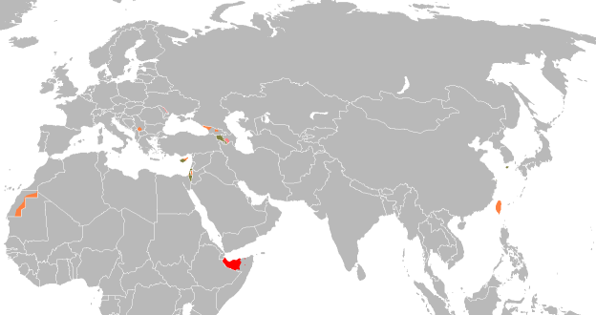
Unrecognized Countries
There are a number of "countries" that exist but are not universally recognized:
Nagorno-Karabakh
Transnistria
Abkhazia
South Ossetia
Kosovo
Somaliland
Northern Cyprus
Palestine
Sahrawi Republic
There are also a number of "countries" created by ongoing civil wars, vanity projects, political exercises, etc.

Slide 64
Geopolitics
Geopolitics is a branch of political geography that looks at the strategic relationships of land and sea and national concerns.
During the 20th century a number of political philosophers considered how geography and politics come together.
One of the most influential concepts was developed by the British geographer Halford J. MacKinder in 1919: the heartland.
Based on European history, MacKinder concluded that whoever controlled the Eurasian heartland would rule the world.
Nicholas Spykman looked at the same history and in 1944 came to the exact opposite conclusion:
The Eurasian heartland is semi-arid and powerless – it was control of the Eurasian rimland that was key to world power.
Does this matter? Directly no – but ideas affect politics (Nazi lebensraum, "domino theory" in Southeast Asia, "containment," etc.).

Slide 65
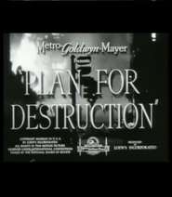
Heartland & Rimland

Slide 66
Terrorism
Terrorism is the systematic use of violence by a group in order to intimidate a population or to coerce a government into granting its demands.
Terrorist acts differ from political assassinations in that they are mostly directed at ordinary people, not at political leaders or military targets.
Historically, the use of the term "terrorist" has been applied to groups outside of any government (or at least not controlled by a government).
Calling someone "terrorist" is often controversial; one faction’s "terrorist" can be another’s "freedom fighter." Hardly anyone thinks of him or herself as a "terrorist"; people think of themselves as "patriots" and "partisans."

Slide 67
Individual Terrorists: Foreign Terrorist Organizations
"Individual" terrorists usually work in groups.
As of January 2012 the US Department of State had designated 51 groups as "Foreign Terrorists."
According to the 2001 USA Patriot Act, to be legally designated a Foreign Terrorist Organization (FTO):
It must be a foreign organization.
It must engage in terrorist activity, or terrorism, or "retain the capability and intent to engage in terrorist activity or terrorism."
The organization's terrorist activity or terrorism must threaten the security of U.S. nationals or the national security (national defense, foreign relations, or the economic interests) of the United States.
http://www.state.gov/j/ct/rls/other/des/123085.htm

Slide 68
US Designated FTOs 2012
Abdallah Azzam Brigades (AAB)
Abu Nidal Organization (ANO)
Abu Sayyaf Group (ASG)
Al-Aqsa Martyrs Brigade (AAMS)
Al-Shabaab
Ansar al-Islam (AAI)
Asbat al-Ansar
Aum Shinrikyo (AUM)
Basque Fatherland and Liberty (ETA)
Communist Party of the Philippines (CPP)
Continuity Irish Republican Army (CIRA)
Gama’a al-Islamiyya (Islamic Group)
HAMAS (Islamic Resistance Movement)
Harakat ul-Jihad-i-Islami/Bangladesh (HUJI-B)
Harakat ul-Mujahidin (HUM)
Hizballah (Party of God)
Islamic Jihad Union (IJU)
Islamic Movement of Uzbekistan (IMU)
Jaish-e-Mohammed (JEM) (Army of Mohammed)
Jemaah Islamiya organization (JI)
Jemmah Anshorut Tauhid (JAT)
Kahane Chai (Kach)
Kata'ib Hizballah (KH)
Kongra-Gel (KGK, formerly PKK, KADEK)
Lashkar-e Tayyiba (LT) (Army of the Righteous)
Lashkar i Jhangvi (LJ)
Liberation Tigers of Tamil Eelam (LTTE)
Libyan Islamic Fighting Group (LIFG)
Moroccan Islamic Combatant Group (GICM)
Mujahedin-e Khalq Organization (MEK)
National Liberation Army (ELN)
Palestine Liberation Front (PLF)
Palestinian Islamic Jihad (PIJ)
Popular Front for the Liberation of Palestine (PFLP)
PFLP-General Command (PFLP-GC)
al-Qai’da in Iraq (AQI)
al-Qa’ida (AQ)
al-Qa'ida in the Arabian Peninsula (AQAP)
al-Qaida in the Islamic Maghreb (formerly GSPC)
Real IRA (RIRA)
Revolutionary Armed Forces of Colombia (FARC)
Revolutionary Organization 17 November (17N)
Revolutionary People’s Liberation Party/Front (DHKP/C)
Revolutionary Struggle (RS)
Shining Path (Sendero Luminoso, SL)
United Self-Defense Forces of Colombia (AUC)
Harakat-ul Jihad Islami (HUJI)
Tehrik-e Taliban Pakistan (TTP)
Jundallah
Army of Islam (AOI)
Indian Mujahideen (IM)
Source: http://www.state.gov/s/ct/rls/other/des/123085.htm

Slide 69
Individual Terrorists: US Domestic Terrorists
The FBI has 3 categories of domestic terrorist organizations in the US:
Right-wing extremist groups (mostly religious, racist, anti-government groups).
Left-wing and Puerto Rican extremist groups (anarchist, socialist, communist groups; Puerto Rican separatists).
Special interest extremists (focused on specific issues: Animal Liberation Front (ALF), Earth Liberation Front (ELF), etc.)
Note that "FBI investigations of domestic terrorist groups or individuals are not predicated upon social or political beliefs; rather, FBI investigations are based upon information regarding planned or actual criminal activity."
At present the US does not publish a formal list of domestic terrorist groups (although the Department of Homeland Security is reportedly preparing a draft for future release). However, The Southern Poverty Law Center's Intelligence Project counted 1,018 active hate groups in the United States in 2011.
Sources: http://www.fbi.gov/congress/congress01/freeh051001.htm;
http://www.splcenter.org/intel/map/hate.jsp

Slide 70
California Hate Groups: A Selection
American Aryan Reich
American Front
American National Socialist Party
American Nazi Party
American Patrol
American Third Position
Aryan Nations 88
Aryan Terror Brigade
As-Sabiqun
Bare Naked Islam
Blood and Honour America Division
California Coalition for Immigration Reform
California Skinheads
Chalcedon Foundation
Chick Publications
Christian Anti-Defamation Commission
Christian Guardians
Concerned American Citizens
Concerned Citizens for the First Amendment
Council of Conservative Citizens
Counter-Currents Publishing
Creativity Alliance
Crew 38
Crusaders for Yahweh
DefendStudents.org
Escaping Islam
European Americans United
Get Some 88
Golden State Skinheads
Holy Nation of Odin
Inconvenient History
Institute for Historical Review
Jewish Defense League
Jihad Watch
League of the South
Life Rune Industries
Masjid al Islam
Nation of Islam
National Alliance
National Black Foot Soldier Network
National Socialist Labor Party
National Socialist Movement
Noontide Press
Official Street Preachers
OMNI Christian Book Club
Save California
Save Our State
South Africa Project
Supreme White Alliance
Temple 88
The Church at Kaweah
Tony Alamo Christian Ministries
Tradition in Action
Traditional Values Coalition
Ku Klux Klan
United Society of Aryan Skinheads
United States Justice Foundation
Vinland Folk Resistance
Voice of Reason Broadcast Network
Volksfront
Voz de Aztlan
Western Hammerskins
Source: http://www.splcenter.org/get-informed/hate-map#s=CA

Slide 71
State-Sponsored Terrorism
Historically, many States have used "volunteers" and "irregular combatants," in wars, including privateers (a kind of state-sanctioned pirate) and guerillas.
States sponsor terrorism and terrorist organizations in several ways:
Sanctuary – providing a safe haven or base of operations for terrorists.
Supplies – giving aid, either in the form of money, or weapons.
Services– providing intelligence, helping to plan terrorist actions.
The US Department of State today lists four countries as State Sponsors of Terrorism: Cuba, Iran, Sudan and Syria.
Sources: http://www.state.gov/s/ct/c14151.htm;
http://www.state.gov/s/ct/rls/pgtrpt/2003/31644.htm;
http://www.artsandopinion.com/2004_v3_n1/lieber.htm

Slide 72
"But I HATE Politics!"
"Politics is not a picture on a wall or a television sitcom you can decide you don't much care for. Is the person who prescribes your eyeglasses qualified to do so? How deep will you be buried when you die? What textbooks are your children learning from at school? What will happen if you become seriously ill? Is the meat you're eating tainted? Will you be able to afford to go to college or to send your kids? Would you like a vacation? Expect to retire before you die? Can you find a job? Drive a car? Afford insurance? Is your credit card company or your banker or your broker ripping you off? It's all politics, Bubba. You don't get to opt out for lack of interest."
"What Difference Does it Make?" Molly Ivins October 29th, 2002 (http://www.sacbee.com/content/opinion/national/ivins/story/4987177p-5996343c.html)

