Slide 1
Industry
The Industrial Revolution
Distribution of Modern Manufacturing
Industrial Location
Problems of Industry

Slide 2
Origins of Industry
In the modern world, industry means “the manufacturing of goods in a factory.”
Industrial activities certainly existed before the modern world – as cottage industry:
Small scale.
Home based (often family based).
Cottage industry still exists – but it’s of little economic importance since the industrial revolution.
Image source: Burke, James. 1985. The Day the Universe Changed. Boston: Little, Brown & Co.

Slide 3
The Industrial Revolution
Revolution is a misleading term – it was a process, not a single event.
The revolution happened because of a coming together of many social, economic, political and technological changes.
The revolution began in Great Britain around 1750 – why here? Why then?
Changes in agriculture (new crops, new agricultural practices, new agricultural machines).
Changes in technology (especially the steam engine – James Watt's improved model of 1769).
Changes in culture (the end of the guilds, the rise of capitalism).

Slide 4
Diffusion of the Revolution: By Industry
Iron, steel and coal [more iron means more need for coal, which means more transportation, which means more use for iron, means better engineering, etc.]
Chemicals, textiles and food [new machines meant more cloth, which meant more need for dyes and bleaches, which meant more and better chemistry, which lead to new ways to preserve food, etc.]
Ceramics [new methods meant cheaper, better ceramics, which meant individual plates and bowls, which improved sanitation, which also lead to the development of ceramic sewer pipes, toilets, etc.]

Slide 5
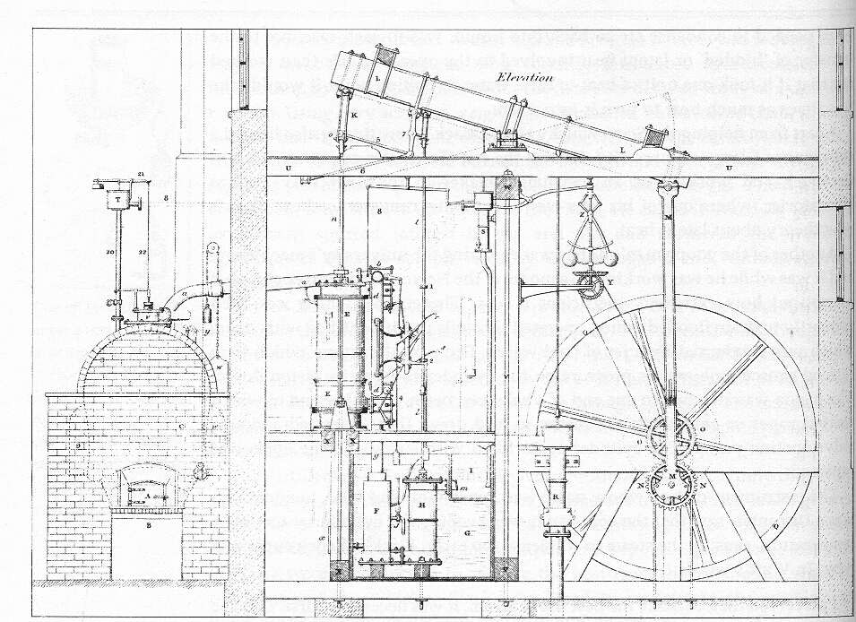
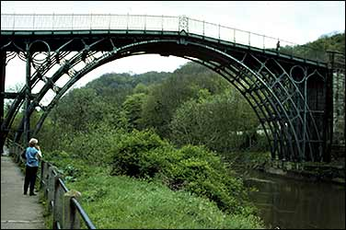
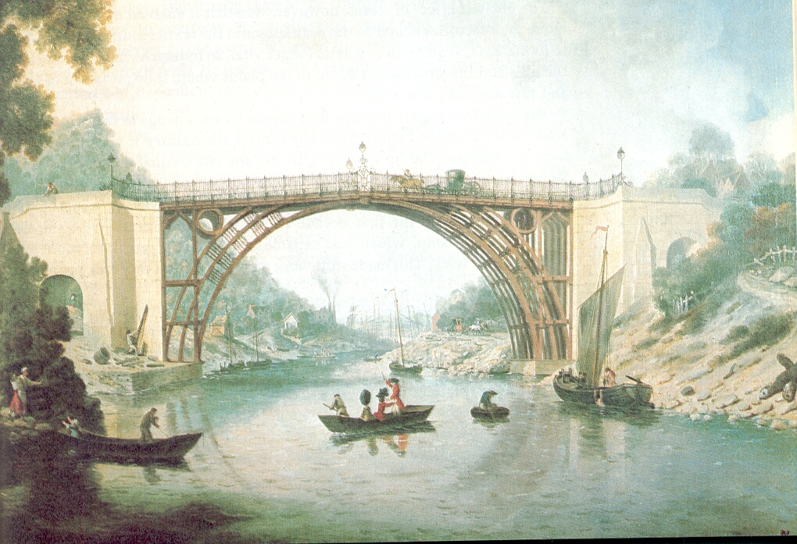
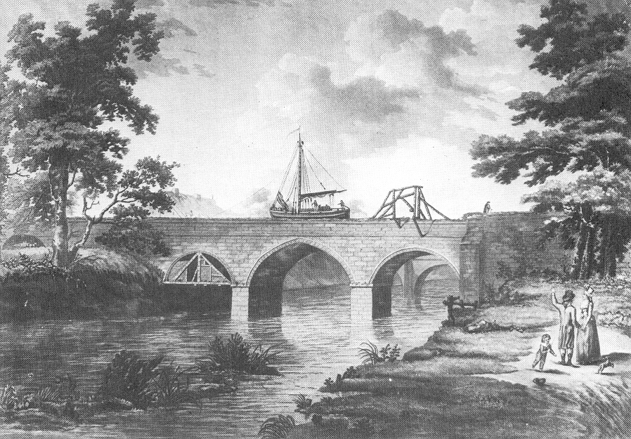
Elements of the Revolution
James Watt’s steam engine
The iron bridge today
The iron bridge at Coalbrookdale
Canal over river
Source: Burke, James. 1985. The Day the Universe Changed. Boston: Little, Brown. ; http://www.pbs.org/wgbh/buildingbig/wonder/structure/iron_bridge.html

Slide 6
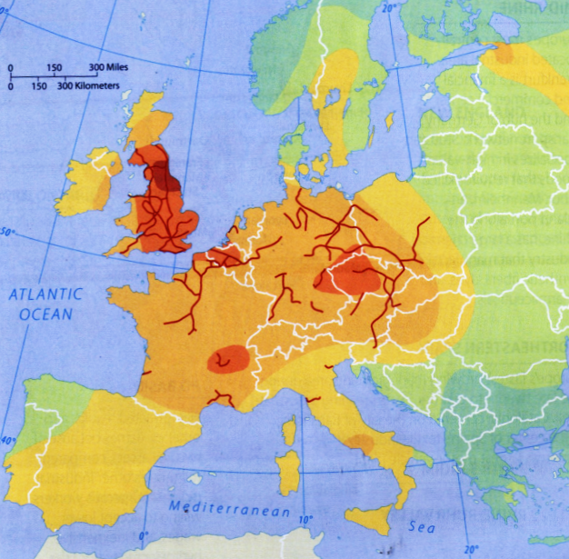
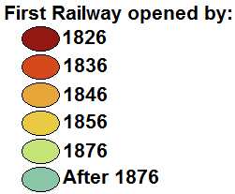
Diffusion of the Revolution: From the UK
The revolution spread from Britain first to:
Europe
North America
Eastern Europe
East Asia
And now – the rest of the world?

Slide 7
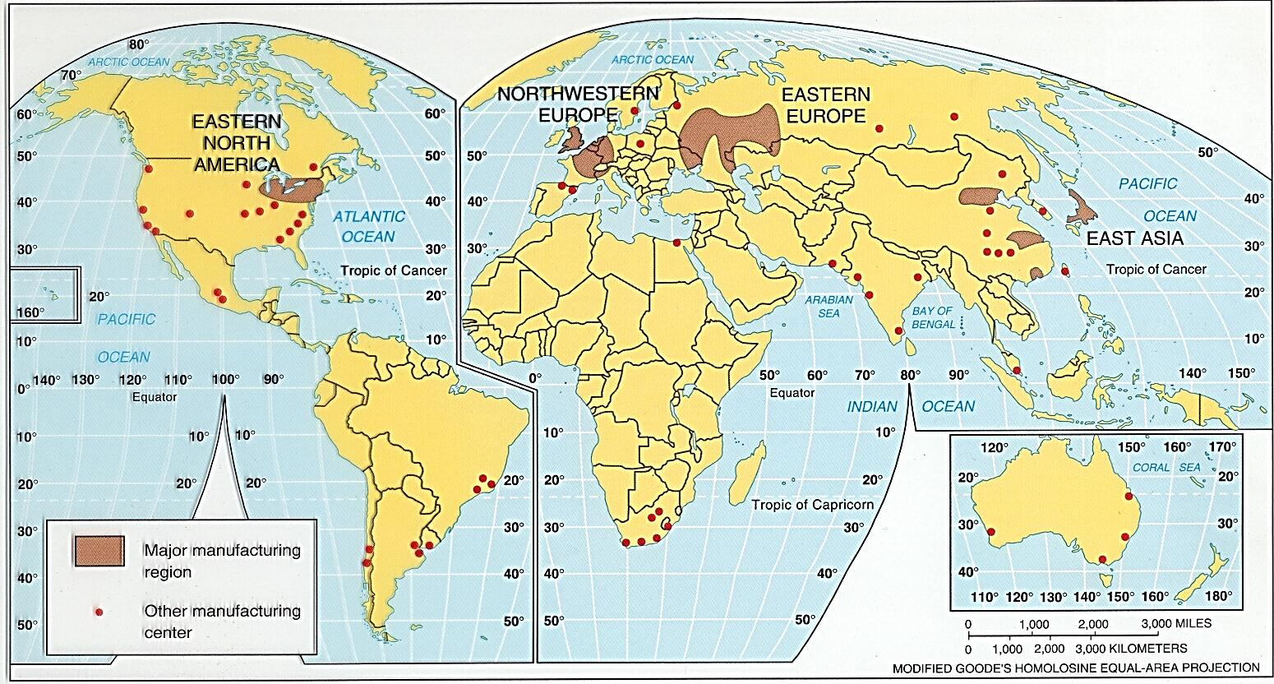
Industrial Regions of the World

Slide 8
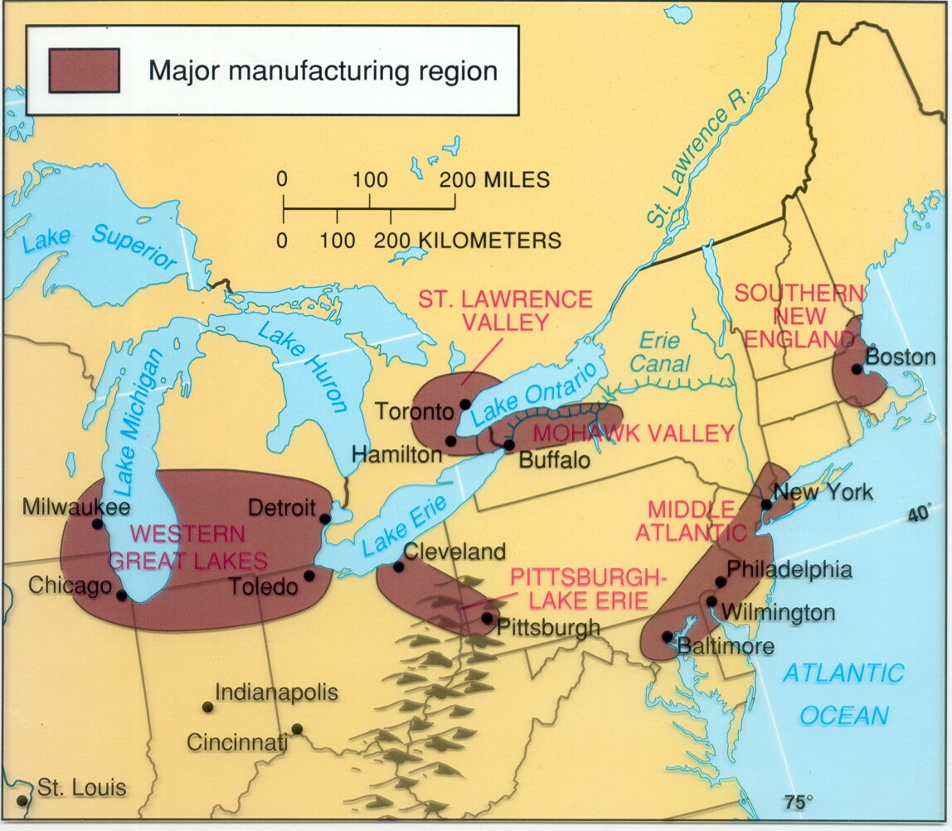
North American Manufacturing

Slide 9
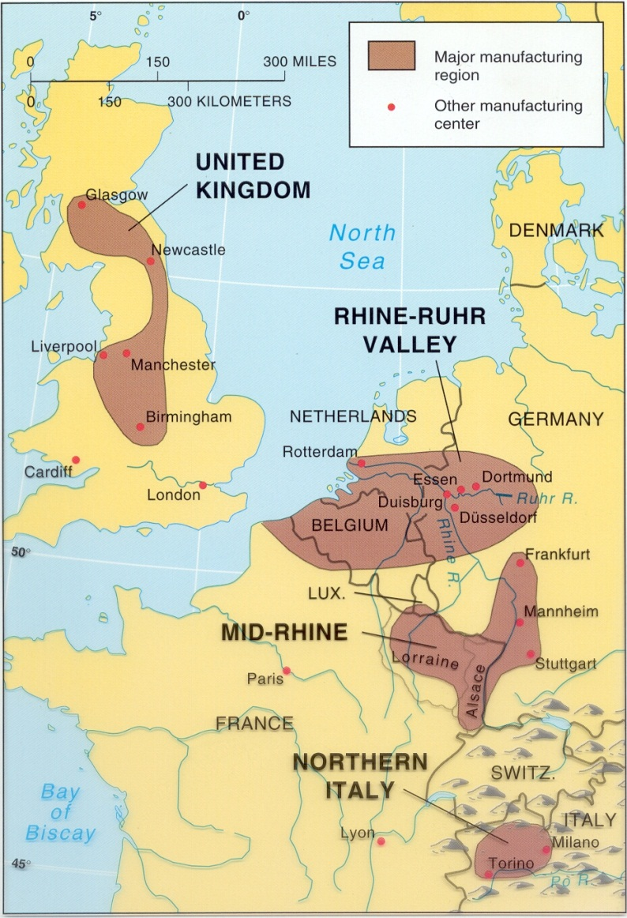
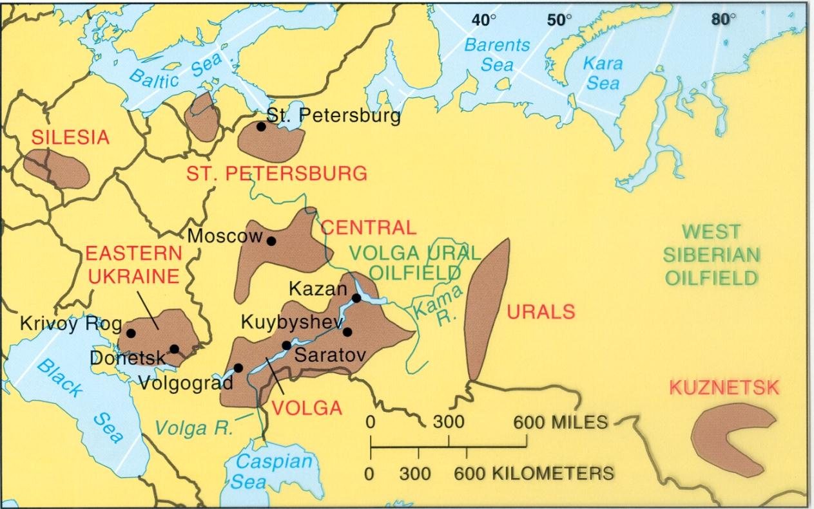
European Manufacturing Regions
Eastern Europe & Russia
Western Europe

Slide 10
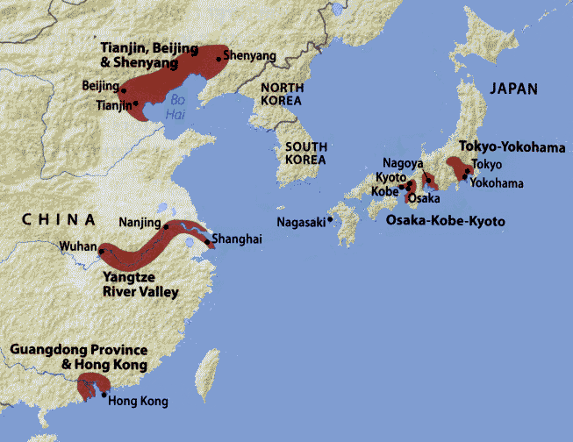
East Asian Manufacturing
Why not include South Korea (12th largest industrial output in 2011) and Taiwan (26th largest)? I have no idea!

Slide 11
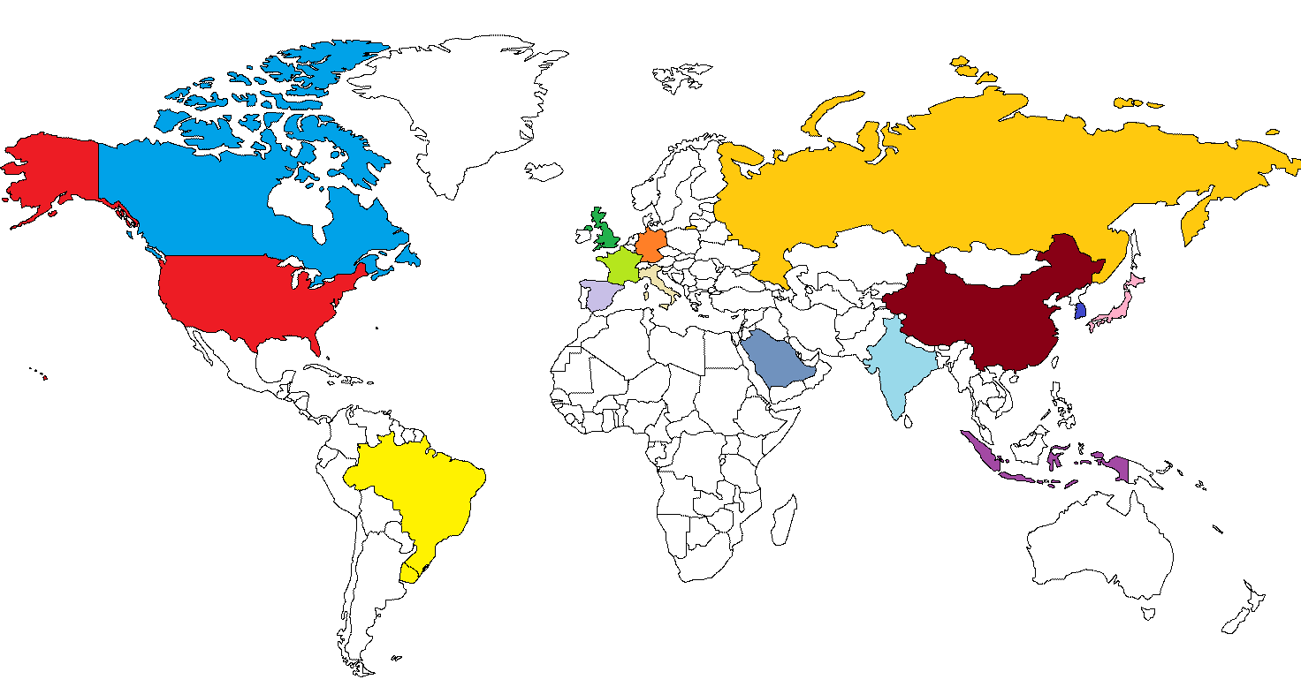
Manufacturing Countries (nominal GDP), 2011
Rank | Country | Industrial Output, $ (millions)
1 | China | 3,415,533
2 | USA | 3,335,780
3 | Japan | 1,408,673
4 | Germany | 1,005,146
5 | Russia | 684,648
6 | Brazil | 670,592
7 | Italy | 554,080
8 | UK | 522,195
9 | France | 513,620
10 | Canada | 476,602
11 | India | 440,826
12 | South Korea | 437,569
13 | Saudi Arabia | 390,454
14 | Indonesia | 389,013
15 | Spain | 386,820

Slide 12
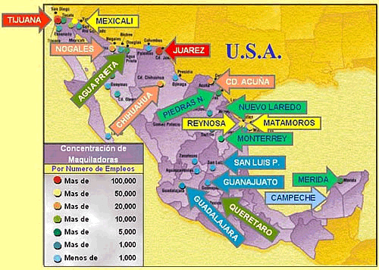
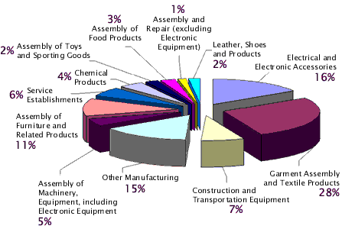
Emerging Industrial Regions: Mexico
Since 1994, with NAFTA (the North American Free Trade Agreement), Mexico has become a major manufacturing nation.
Originally located along the US-Mexico border, maquiladoras are now found throughout Mexico.
Mexico’s original advantages – location, low transportation costs, and cheap labor – aren’t quite as important as they used to be (and labor here has struggled to match prices in other parts of the world), but Mexico is still a major source of industrial goods for the US market.
Sources: http://www.fsa.ulaval.ca/personnel/VernaG/EH/F/manif/lectures/Maquiladoras/factsheet.html; http://latinalista.blogspot.com/2006/08/special-maquiladora-helps-displaced.html

Slide 13
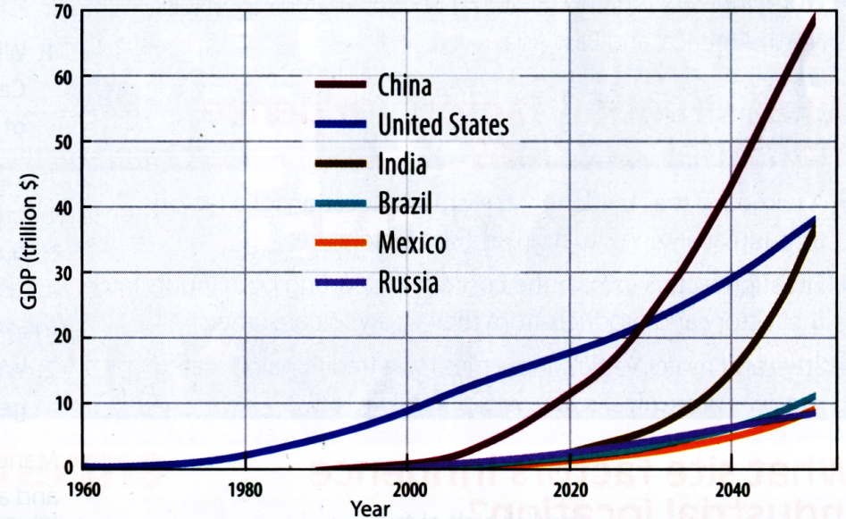
Emerging Industrial Regions: BRIC
B.R.I.C.: Brazil, Russia, India and China.
Today, Europe, North America and East Asia are where about 75% of the world’s manufacturing is located.
By the middle of this century, the BRICs are expected to dominate global manufacturing.

Slide 14
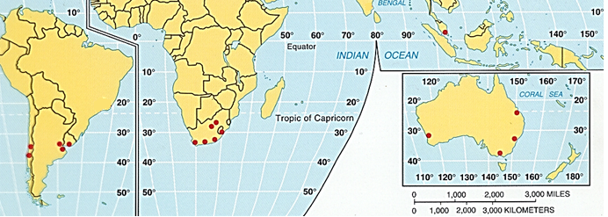
Emerging Industrial Regions: Other Regions
South America
Chile: Iron & steel; fish & food processing; wood products; textiles; heavy equipment.
Argentina: Food processing; vehicles; durable goods; textiles; chemicals; steel
Africa
South Africa: Metals processing; vehicle assembly; machinery; textiles; iron & steel; fertilzers; food processing; shipbuilding. Sometimes included in the BRICS.
Southeast Asia
Malaysia: Rubber, oil and palm oil processing; pharmaceuticals; electronics; tin smelting; wood products.
Australia: Mining; heavy equipment & vehicles; food processing; chemicals; steel.
Data source: https://www.cia.gov/library/publications/the-world-factbook/index.html

Slide 15
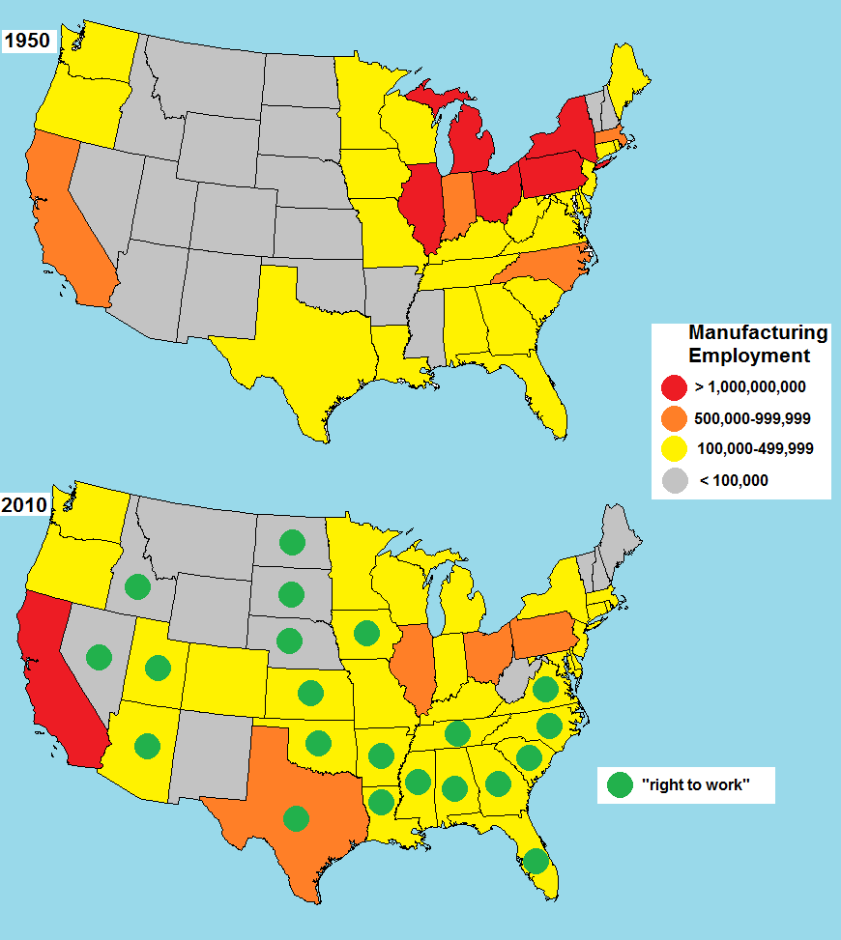
Changing Industrial Location: The US
There has been a shift of manufacturing from the traditional “core” to the South and Western US.
Several factors are important: Population growth in the West and South; Transportation changes and a focus on exports and imports; and “right to work” laws in many states.

Slide 16
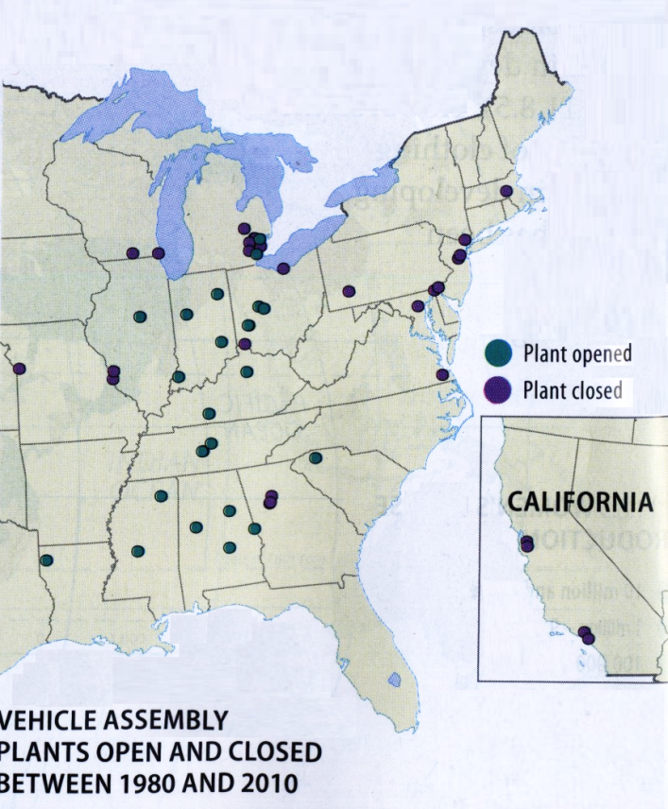
“Right to Work”
“Right to work” laws affect unions and worker rights.
Twenty-three states have “right to work” laws.
The goal is to prevent a “closed shop” – a workplace where workers are required to be union members.
In “right to work” states, although unions may negotiate contracts, no worker can be required to be a member of a union.
HOWEVER – closed shops have been illegal in all parts of the US since 1947.
In states that do not have “right to work” laws, workers who are not members of a union may be required to pay a “fair share” or “agency fee,” but are not required to join a union and do not pay full union dues.
Some manufacturers in some industries definitely prefer “right to work” states.

Slide 17
Industrial Location
In a primary economic activity – like agriculture, fishing, forestry, or mining – there isn't much location choice – you go where the soil is good, where the gold is, etc.
But industry – a secondary economic activity – like manufacturing, construction, any operation that modifies a product and adds value – can try to choose the best possible location based on rational economic factors.

Slide 18
Industrial Location: Situation
Proximity to Inputs:
If an industry's inputs are heavy, bulky, or fragile, then it may make sense to locate near where those inputs come from.
Examples: copper, steel, canned tomatoes
Because what goes in the factory is heavier or bulkier than what comes out, these are often called weight-reducing or bulk-reducing industries.
Proximity to Markets:
If an industry's outputs are heavy, bulky, or fragile, then it may make sense to locate near the market.
Examples: beer, glass, concrete, air conditioners
Because what comes out of the factory is heavier or bulkier than what goes in, these are often called weight-gaining or bulk-gaining industries.
Other industries may also locate near markets:
Single-market manufacturing (auto parts)
Perishable manufacturing (milk)

Slide 19
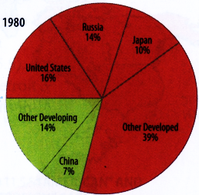
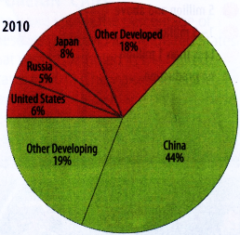
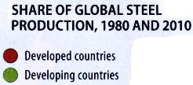
Changing Situation – Changing Locations
Manufacturing is in the process of shifting from the developed to the less developed world.
This is largely because of situation changes – especially changing transportation methods and changing costs of labor.

Slide 20
You need to sell VW cars from Germany to the city of Atlanta, GA.
ID where you’d assemble the cars prior to sale.
ID and Explain why VW would locate the assembly plant in that location.
ID and Explain how you would transport them to market from the assembly plant.

Slide 21
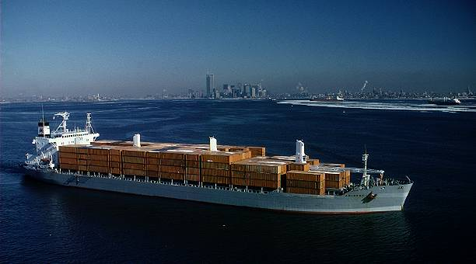
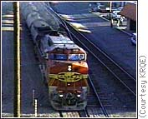
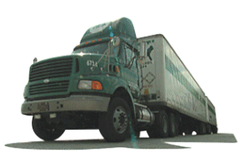
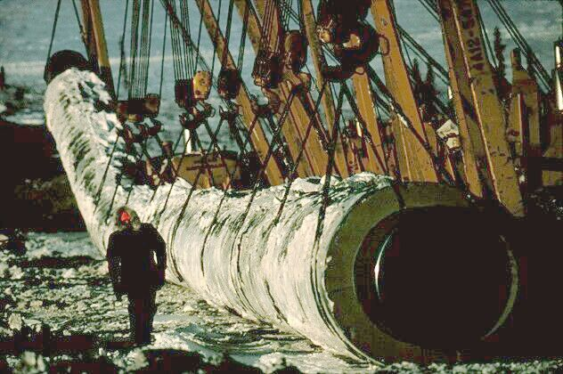
Transportation
Containerized shipping
Depending on what is being manufactured, the cost and method of transportation may also have an impact on industrial location decisions.
Methods of transportation:
Ship (very low cost, very slow, best suited to long distance).
Rail (low cost [usually], slow to moderate speed [usually], suitable for long or medium distances).
Trucking (high cost [per ton], moderate to high speed, extremely flexible, suitable for long, medium or short distance).
Air (very high cost, very high speed, suitable for medium or long distance).
Pipeline (very low cost, but only suitable for bulk liquids)

Slide 22
Break of Bulk Points
Break-of-bulk points (or “break-bulk points”)
A break-of-bulk point is place where you transfer goods from one kind of transport to another.
Every time you go from one transportation method to another – from rail to truck, for example – it takes time and costs money.

Slide 23
“Just-in-Time”
Just-in-time delivery is the shipment of parts and materials to arrive at a factory exactly when they’re needed.
Advantages
Manufacturers no longer need large parts or supply inventories – so no buying of unneeded materials.
Manufacturers can have smaller factories.
Manufacturers no longer need to store large quantities of parts – so no need for warehouse space.
Disadvantages
Anything that prevents shipping –traffic, natural disasters, political problems, power failures, anything at all – can completely disrupt manufacturing.
Labor unrest at any point in the supply chain can close the factory!

Slide 24
Industrial Location: Site
Site describes the physical (or fixed) characteristics of a location.
Different industries have different needs, and different sites are best suited to different industries.
Site factors include the availability and cost of:
Labor (unskilled or skilled, depending on the industry)
Land (some industries need large areas)
Power (some industries need large amounts of power)
Capital (money to start or expand a business)
It isn’t always possible to find a perfect location – so compromises have to be made.
Some industries today are footloose – they can locate essentially anywhere.

Slide 25
Labor-intensive Industries
Manufacturers always want to minimize labor costs.
The look for lower cost labor leads different industries in different directions, depending on needs:
Unskilled labor
Some manufacturers – especially Transnational Corporations – seek the cheapest possible labor.
“New International Division of Labor”
Outsourcing
“Maquiladoras” – but these may not be the cheapest any more!
Skilled labor
Some manufacturers still need cheap unskilled “Fordist” assembly-line mass production
But some – especially high-tech manufacturers – need highly skilled, highly educated “Post/Neo-Fordist” labor
Note that “high-wage” is not the same as “labor-intensive”

Slide 26
Different Site Characteristics – Different Manufacturing
Yarn
Fabric
Textiles are a labor intensive industry – but some aspects require skilled labor, some unskilled.
Transportation costs and proximity to markets are also factors in choosing manufacturing locations.
Clothing

Slide 27
Problems of Modern Industry
Stagnant demand:
The best markets for manufactured goods are in the developed world – but the population of the developed world isn't growing.
Demand for many consumer goods is stagnant because markets are saturated – for many goods there is a limit to how much or how many consumers are willing to buy.
“The Decline of Shoddy” – increased global competition means that shoddy goods get replaced – but goods that don't break don't need to be replaced, so demand stays low.
Improved technology has increased demand for some products, but decreased demand for others.
Increased capacity at the global scale means increased competition – manufacturing is no longer concentrated in just a few countries – all the developed and many developing countries have advanced manufacturing capabilities.

Slide 28
Industrial Problems in More Developed Countries
Trading Blocs (e.g. NAFTA, European Union):
Trade within blocs is increased – but trade with the outside world may be decreased.
Competition tends to take place between blocs rather than on a country-by-country basis.

Slide 29
Industrial Problems in Less Developed Countries
Distance from markets (remember the “core and periphery” model).
Lack of infrastructure.
Lack of investment.
Dominance by transnational corporations:
Dependence on more developed countries (for supplies and markets).
Concentration on low-skilled labor.
The “race-to-the-bottom.”

Slide 30
Industrial Problems in Less Developed Countries
Peripheral economies
Remember – as we discussed before, most foreign investment is between developed countries.

